Slide 1
April 2024
ONVIF Add-on Concept & TLS Configuration Add-on Explained
©All rights reserved.
Notes:
©All rights reserved. Please obtain permission for the use of any ONVIF artwork. Any ONVIF artwork must be credited to ONVIF.

Slide 2
Topics
ONVIF Add-on Concept
TLS Configuration Add-on
Use Cases & Scenarios
Obtaining Conformance for an Add-On
Conclusion
Q&A

Slide 3
ONVIF Add-on Concept

Slide 4
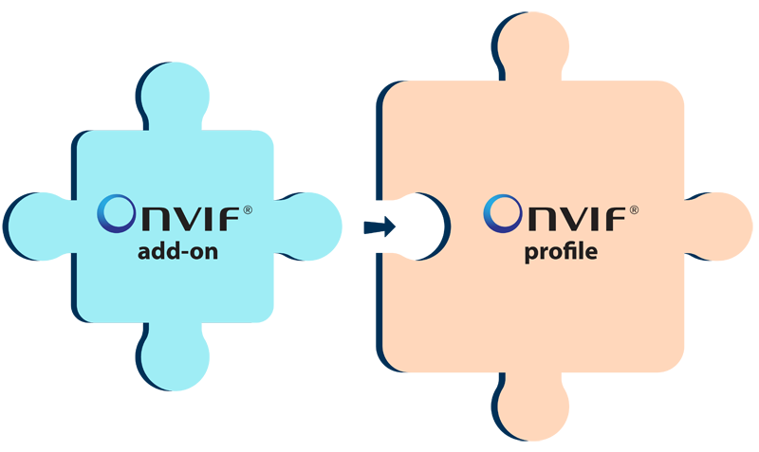
ONVIF Add-on
One or more features that solve one use case
  Not enough to qualify as a profile by itself
Allows for version handling
  Features can be added/removed if there is market justification
Devices/clients claiming add-on conformance must:
  Pass add-on conformance tests
  Conform to an ONVIF profile

Slide 5
Benefits of Add-on
For manufacturers
  Allows ONVIF profile conformant device/client to claim conformance to additional capabilities outside of profiles
  Easier and quicker to develop and release due to its limited features as compared with a profile
For end-users and system integrators
  Flexibility for market-specific scenarios
  Interoperability

Slide 6
Profile vs. Add-on
Key Differences and Similarities | Applicable for ONVIF profile | Applicable for ONVIF add-on
Comprehensive enough to allow functional product development on its own | Yes | No
Adaptable through version handling | No | Yes
Covers specifications for both client and device | Yes | Yes
Both client and device must pass conformance tests to claim conformance | Yes | Yes
Can be proposed by any ONVIF member, but can only be developed by ONVIF full and contributing members | Yes | Yes

Slide 7
ONVIF TLS Configuration Add-on

Slide 8
TLS Configuration Add-on
For encrypted communication using Transport Layer Security (TLS)
TLS encrypts communications to make it more difficult for cyber threats such as eavesdropping and intrusions to occur
First ONVIF add-on, enabling secure communications in physical security systems when using products conformant with the add-on

Slide 9

Why is it needed?
Cybersecurity is increasingly a priority for businesses
Key market demand
  Standardized way to secure communications between IP-based physical security products from different manufacturers

Slide 10

What is it?
Provides a baseline for encrypted communications between a client and device that conform with the ONVIF add-on
Regardless of brand, a client with this add-on will be able to configure and update the TLS settings on a device with the same add-on
For encrypted communication using TLS

Slide 11
Use Cases | Scenarios

Slide 12
Use Cases
Preventing
  TLS secures communications between VMS and devices, ensuring authentication credentials are not stolen during transmission
  Allows VMS to confirm the identity of the camera using certificates
Securing
  Prevent unknown parties from observing video data from cameras by encrypting video streams

Slide 13
Scenarios
The TLS Configuration Add-on can be bundled easily with other profiles and add-ons
Combined with Profile T to encrypt video traffic
Combined with Profile M for the security of analytics data
Notes:
MICHAEL Another example, TLS will enable encrypting all configuration and setup traffic as well for all profiles. (HTTPS, etc)

Slide 14
Obtaining Conformance for an Add-on

Slide 15




Value of Add-on Conformance
Add-on conformance allows ONVIF profile conformant devices/clients to claim conformance to additional capabilities, allowing for even greater functionality.
Streamlined process with limited features
Easier and quicker to develop and release due to its limited features as compared with a profile
Customization options for specific requirements
Adaptability to changing technology and market needs

Slide 16
ONVIF Conformance Process
Self-declaration by ONVIF member for its products
Pass
device/client
test tool
New tool versions released every June & December
Implement an ONVIF add-on with an ONVIF profile
Developers’ Plugfest
Verification with other member conformant products
Submission to ONVIF
DoC
Interface Guide
Feature list
For details, see the ONVIF Conformance Process at onvif.org/profiles/conformance

Slide 17
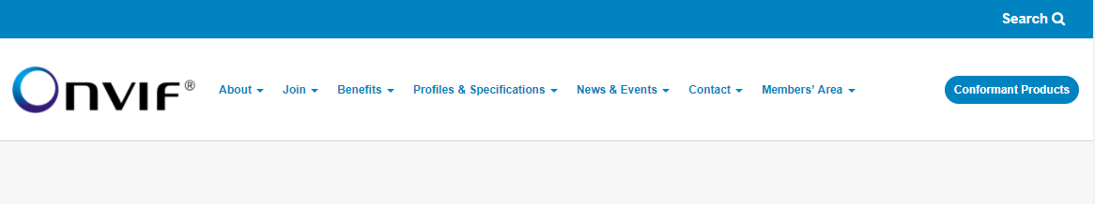

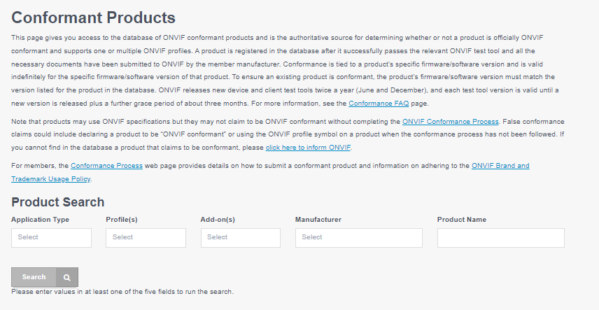
How to find Add-on Conformant Products
Check that the product and firmware/software version is listed here on the ONVIF website at:
onvif.org/conformant-products/
Site is the only authoritative source for all ONVIF conformant products

Slide 18
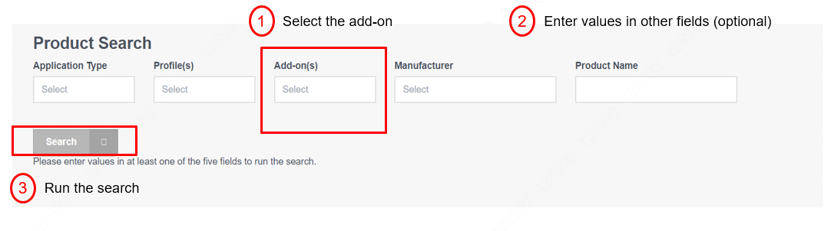
Product Search

Slide 19
Conclusion

Slide 20
Add-on Concept and TLS Configuration
Add-on Concept
TLS Configuration
An adaptable feature set that complements existing profiles
Mandatory add-on conformance tests
Encrypted communication in physical security systems
First ONVIF add-on
A standardized way for a client to be able to configure and update TLS settings on a device

Slide 21
Benefits
Add-on Concept
TLS Configuration Add-on
For manufacturers
Quick responsiveness
Flexibility of features
A differentiating feature for the ONVIF conformant product portfolio
For end-users and system integrators
Flexibility for market-specific scenarios
No need to look outside the ONVIF ecosystem for specific demands
Unified configurations and updates of TLS setting
More peace of mind from cyber threats

