Slide 1
November 2022
ONVIF Conformance
Spaker
©All rights reserved.
Notes:
©All rights reserved. Please obtain permission for the use of any ONVIF artwork. Any ONVIF artwork must be credited to ONVIF.

Slide 2
Topics
Overview
  Cornerstones of ONVIF
  Benefits of ONVIF Conformance
What Does ONVIF Conformance Mean?
  How Do You Know if a Product is ONVIF Conformant?
  ONVIF Conformance
  Misconceptions About ONVIF Conformance
  ONVIF Conformance Process
  Profile and Supported Features
  Device and Client Test Tools
  Conformant Product Information
  Checklist
  Logo and profile symbols

Slide 3
Overview

Slide 4
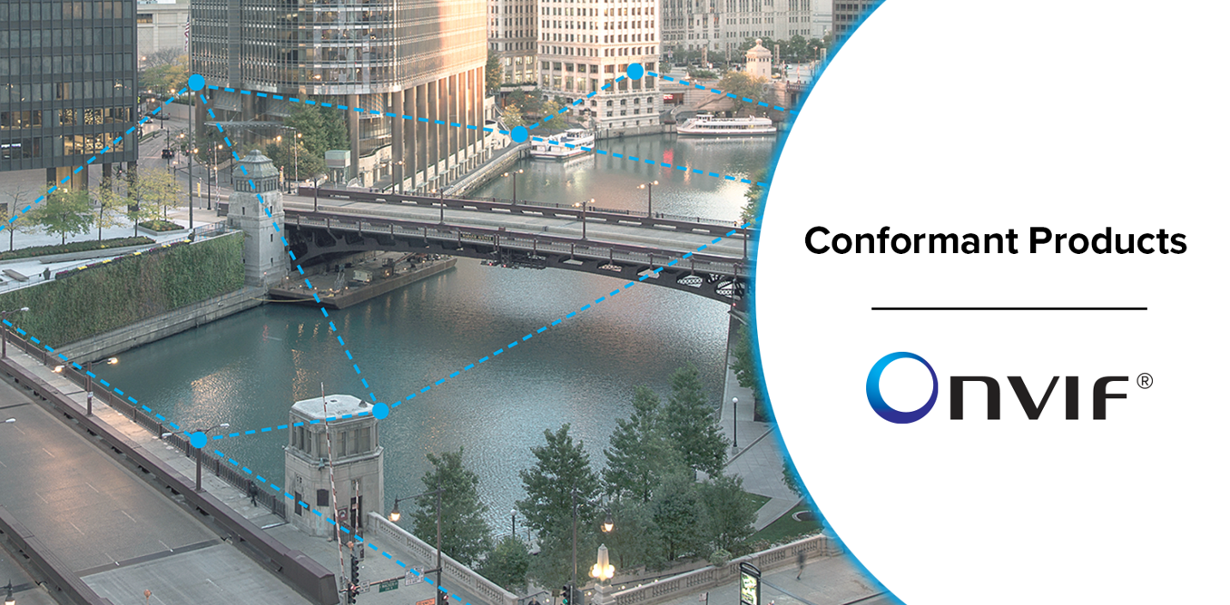
ONVIF Profile Conformant Products
ONVIF Profile A, C, G, M, S and T conformant products.
24,000+

Slide 5
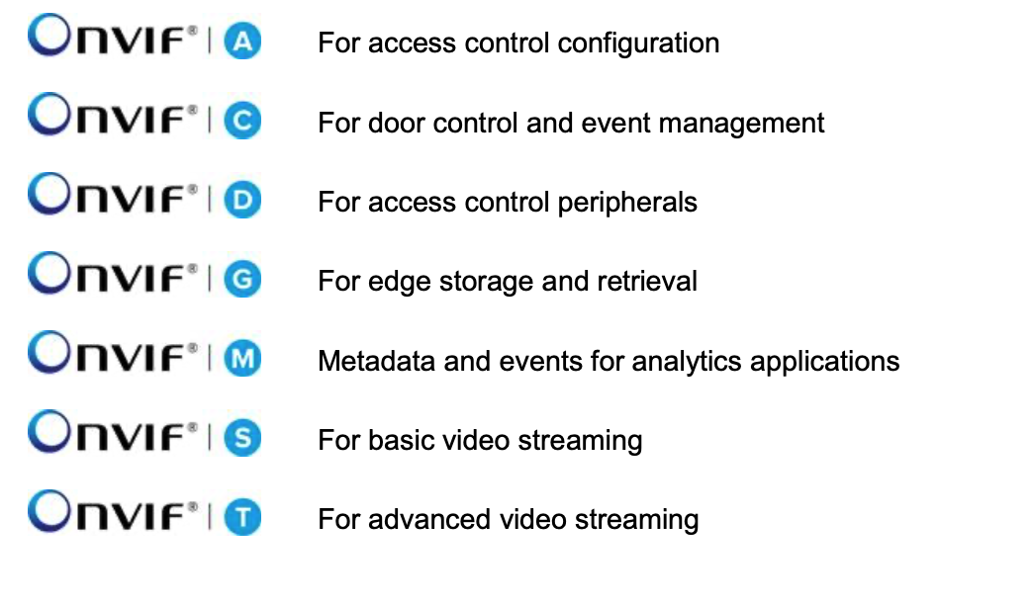
ONVIF Profiles

Slide 6

Cornerstones of ONVIF
Standardization of communication
between IP-based physical security
products
Interoperability regardless of brand
Openness to all companies and organizations

Slide 7



Benefits of ONVIF Conformance
Enables different brands of products to work together, eliminating the need to develop specific drivers
End users
Greater flexibility & choice
No brand lock-in
Future proof
Integrators
Greater flexibility & choice
Easier integration
Future proof
Manufacturers
Easier market acceptance
Help win projects
Drive industry growth

Slide 8
What does ONVIF conformance mean?

Slide 9
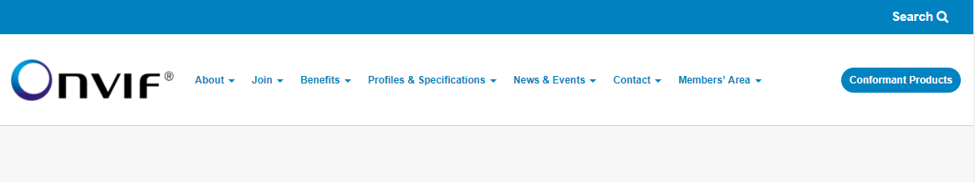

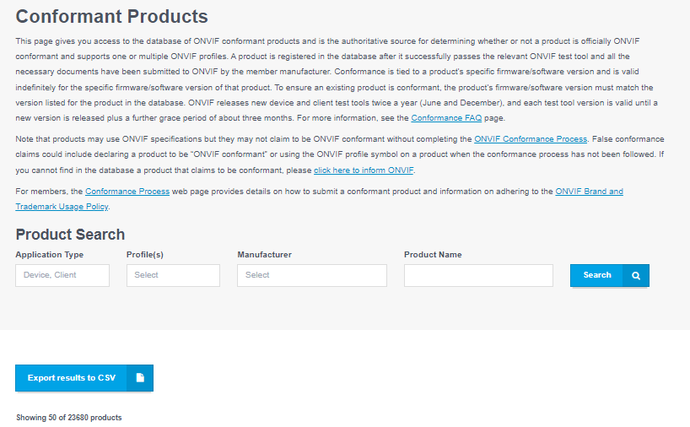
How to know if a product is ONVIF conformant
Check that the product and firmware/software version is listed here on the ONVIF website at:
onvif.org/conformant-products/
Site is the only authoritative source for all ONVIF conformant products

Slide 10

ONVIF Conformance
For a product to be listed as conformant on the ONVIF website/database, it must meet the following criteria:
The product is claimed by an ONVIF member
The product, together with a specific firmware/software version, conforms to one or more ONVIF profiles
It has completed the ONVIF Conformance Process
Passing the ONVIF device/client test tool for one or many ONVIF profile(s)
Relevant documents have been submitted by the manufacturer to ONVIF through the Member Portal

Slide 11

Misconceptions About ONVIF Conformance
Membership does not equal conformance
Conformance is not a mark of quality or endorsement from ONVIF
ONVIF does not provide certificates of conformance or other guarantees of conformance
Products may use ONVIF specifications but they may not claim to be ONVIF conformant without completing the ONVIF Conformance Process
For details, see the ONVIF Brand and Trademark Usage Policy at
onvif.org/wp-content/uploads/2022/05/onvif-brand-standards-20220516.pdf

Slide 12
ONVIF Conformance Process
Self-declaration by ONVIF member for its products
Pass
device/client
test tool
New tool versions released every June & December
Implement mandatory + conditional features of ONVIF profile
Developers’ Plugfest
Verification with other member conformant products
Submission to ONVIF
DoC
Interface Guide
Feature list
For details, see the ONVIF Conformance Process at onvif.org/profiles/conformance

Slide 13
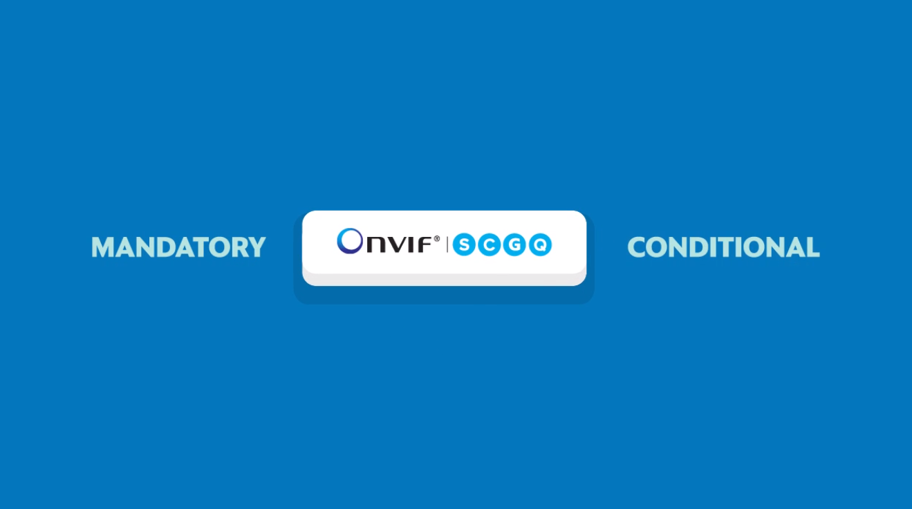
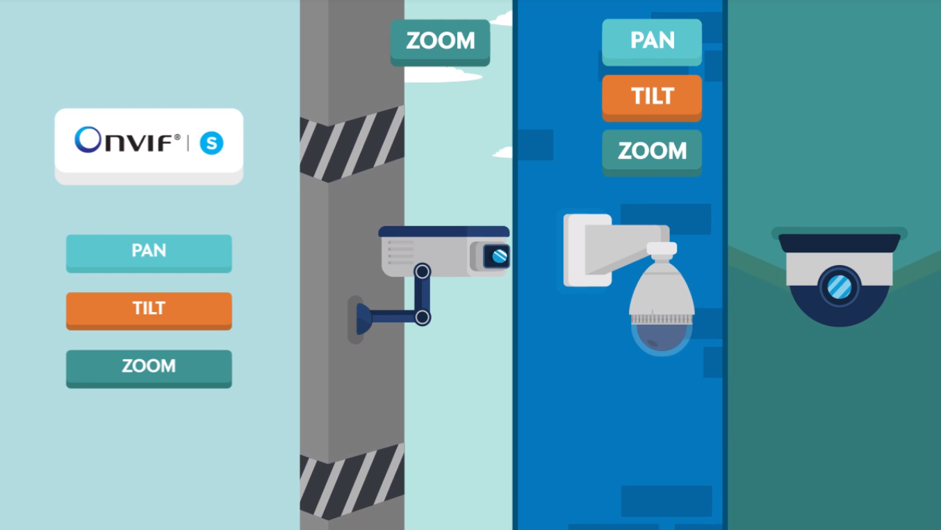
Profile & Supported Features
Features in a profile are either mandatory or conditional
Mandatory features must be supported
Conditional features only supported if relevant
  i.e., PTZ functions can only be supported in PTZ cameras

Slide 14
ONVIF Device & Client Test Tools
Designed to:
Not designed to:
Discover all APIs specified by ONVIF profiles and many more beyond profile specifications
Check for correct API implementation and determine if the product supports the necessary APIs to meet various profile requirements
All supported ONVIF APIs are reported in the product’s Declaration of Conformance (DoC) document
Assess quality of feature implementation
Check compatibility between a device and client
  Does not test specific interactions between client and device
Check that conditional features of a profile are implemented

Slide 15
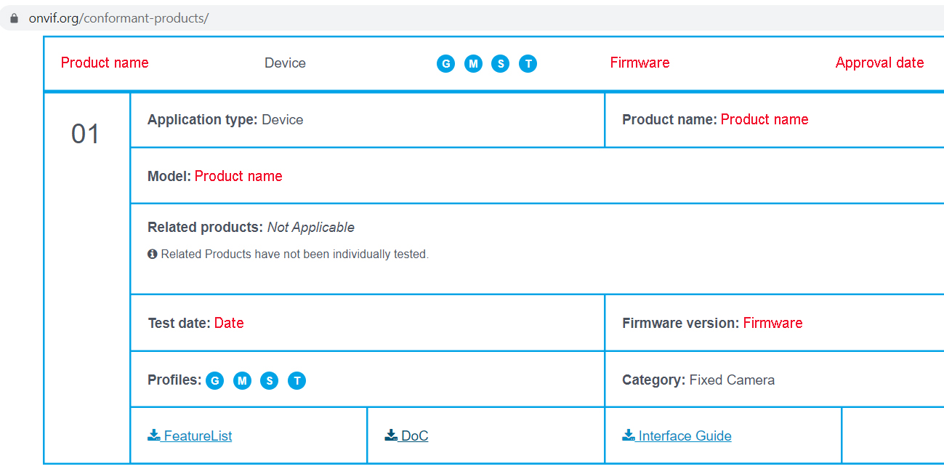

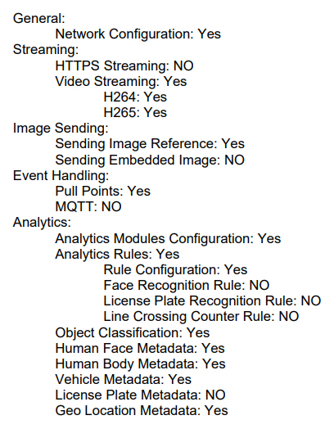

Conformant Product Information

Slide 16
Interface Guide
Configuration requirements to set up product
  Product information
  Supported profile(s)
  Information for contacting product support
  Prerequisites
  Installation information
  Default network settings
  Initial login information (i.e. how to create unique username/password, initial device discovery)
  Local configuration (i.e. setup related to ONVIF features)
  How to enable ONVIF behaviors (if applicable)
  Query capabiliites

Slide 17
Checklist that raises compatibility levels between a conformant device & client
Check device and client for same ONVIF profile conformance
Check device and client for same supported ONVIF features (especially important for conditional features of profiles)
on manufacturer datasheet
on Onvif.org/conformant-products with model name + firmware/software version
in ONVIF DoC of both device and client

Slide 18



Logo and Profile Symbols
Artwork to be used only by ONVIF and its members
 | For promoting ONVIF | Not for declaring ONVIF membership Does not denote an ONVIF conformant product Not for use with any product
 | For declaring ONVIF membership | Does not denote an ONVIF conformant product Not for use with any product
 | For declaring ONVIF product conformance to one or more profiles | Not for use in declaring ONVIF membership
ONVIF actively pursues false claims to protect the ONVIF brand
Improper conformance claims can be reported at: onvif.org/contact/report-improper-conformance-claim/

Slide 19
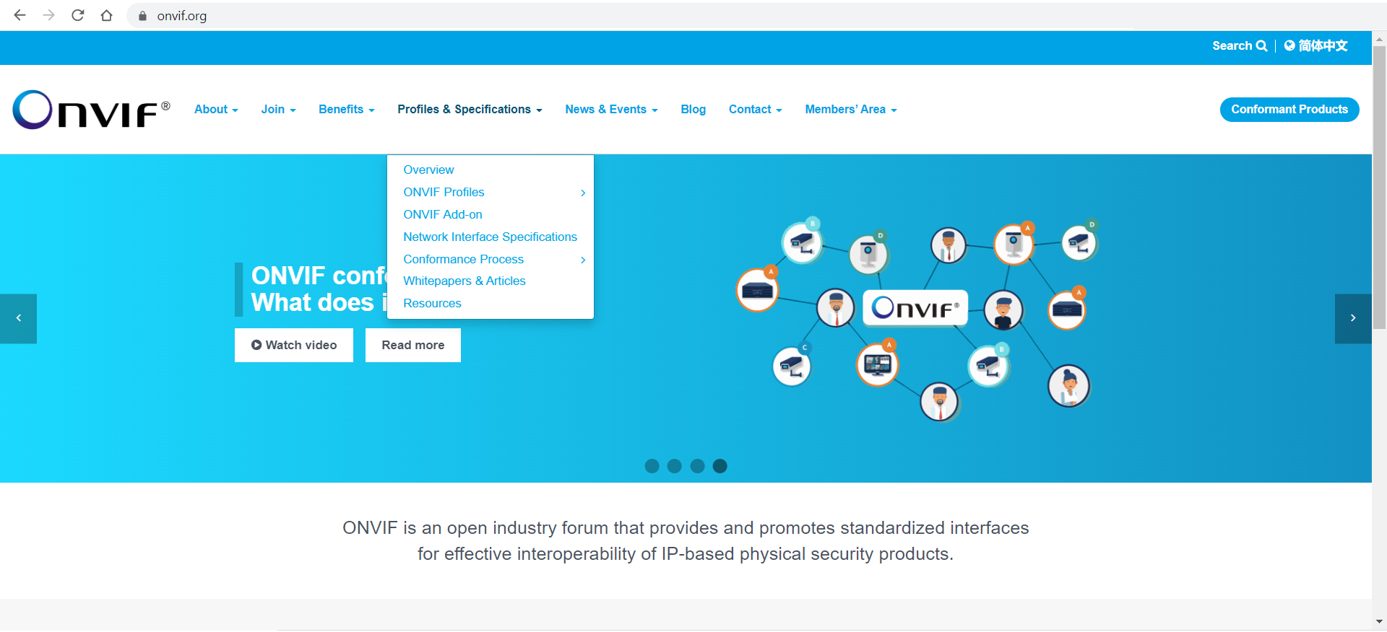
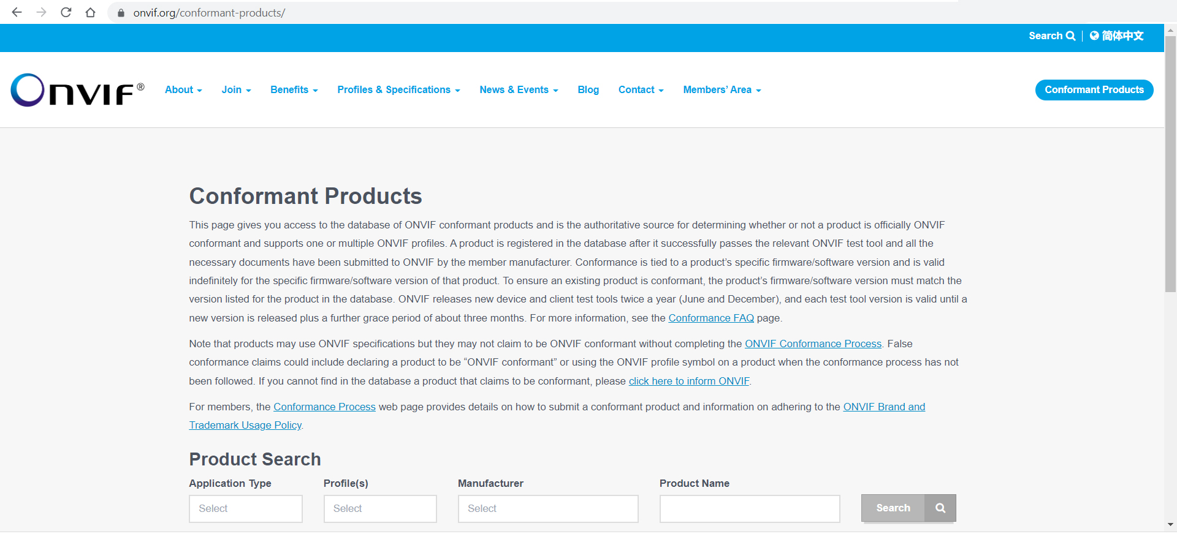
Resources
onvif.org/profiles/conformance/
onvif.org/conformant-products/
onvif.org/wp-content/uploads/2022/05/onvif-brand-standards-20220516.pdf

