Slide 1
May 2022
ONVIF Profile M
©All rights reserved.
Notes:
©All rights reserved. Please obtain permission for the use of any ONVIF artwork. Any ONVIF artwork must be credited to ONVIF.

Slide 2


Interoperability demands for analytics applications
Rise in analytics applications for security and safety, business intelligence and IoT devices
  Security – Object detection, classification, tracking
  Business Intelligence – People counting, vehicle traffic analysis
  IoT – Smart building management
Metadata helps tag elements in a scene
    Highlight certain objects, including, for instance, heat mapping in a retail store or vehicle mapping in a parking lot
    Trigger automatic responses
    Effectively store and search for content of interest
Notes:
As we know, analytics applications for security and safety, business intelligence and IoT devices are on the rise.
Examples:
In security and safety, we have applications that support object detection, classification and tracking. Use cases include perimeter or area protection, tailgating and parking violation detection.
In business intelligence, examples include people counting, occupancy estimation, store monitoring, as well as store traffic and vehicle traffic analysis
In IoT, applications include smart building management
Analytics applications can provide metadata that provide intelligence to a system. In the context of video, metadata (which can be a variety of object classifications) is data that helps tag elements in a scene.
Metadata can be used to highlight certain objects in a video stream – and it can include heat mapping in a retail store using human and geolocation metadata, and vehicle mapping in a parking lot using vehicle and geolocation metadata. Metadata can also be used to trigger automatic responses (depending on how the system is set up), and effectively store and search for video content of interest.
ONVIF members saw that the industry and market can benefit from the standardization of metadata and events so that more elements in a system can work together regardless of brand. ONVIF Profile M was launched on June 30, 2021.
So how does ONVIF Profile M address the interoperability demands for analytics applications?

Slide 3


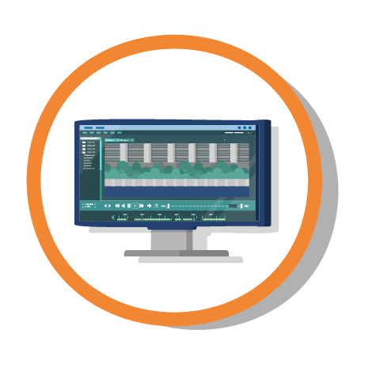
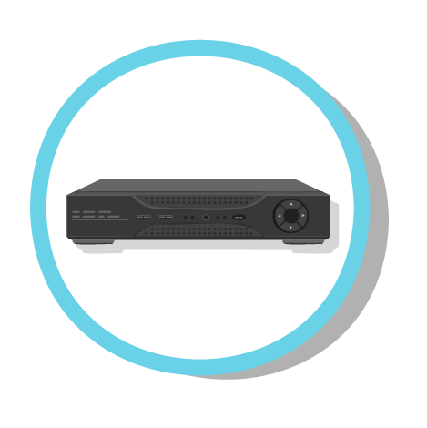



ONVIF Profile M – Summary
Metadata and events for analytics applications
Supported metadata
Supported events
Streaming metadata and sending events
< Standardized metadata stream >
[Analytics metadata | XML events | PTZ positions]
Conformant devices
(including services)
Conformant clients
Notes:
ONVIF Profile M supports analytics applications through
Standardized metadata for specific objects and standardized container for generic object classifications (More on slide 5.)
Standardized event topics for specific analytics applications (More on slide 6.)
Standardized interfaces for streaming analytics metadata and sending events (More on slide 7.)
Profile M essentially aims to standardize interfaces that specify how devices/clients should send/retrieve and interpret analytics metadata, as well as handle events. More info on each of these points will be dealt with in later slides.
A Profile M conformant device can be an IP camera or a service (e.g. server- or cloud-based application) with analytics capabilities that can use Profile M interfaces to send metadata over an IP network to a client.
Note that Profile M specifications deliberately relaxed requirements on device/network/system management to enable a variety of software-based analytics solutions to potentially be a Profile M conformant device.
A Profile M conformant client can be a video management software (VMS) program, a network video recorder (NVR), or a server- or cloud-based service that can make use of Profile M interfaces to configure, request and control the streaming of metadata over an IP network from a Profile M device or service.

Slide 4
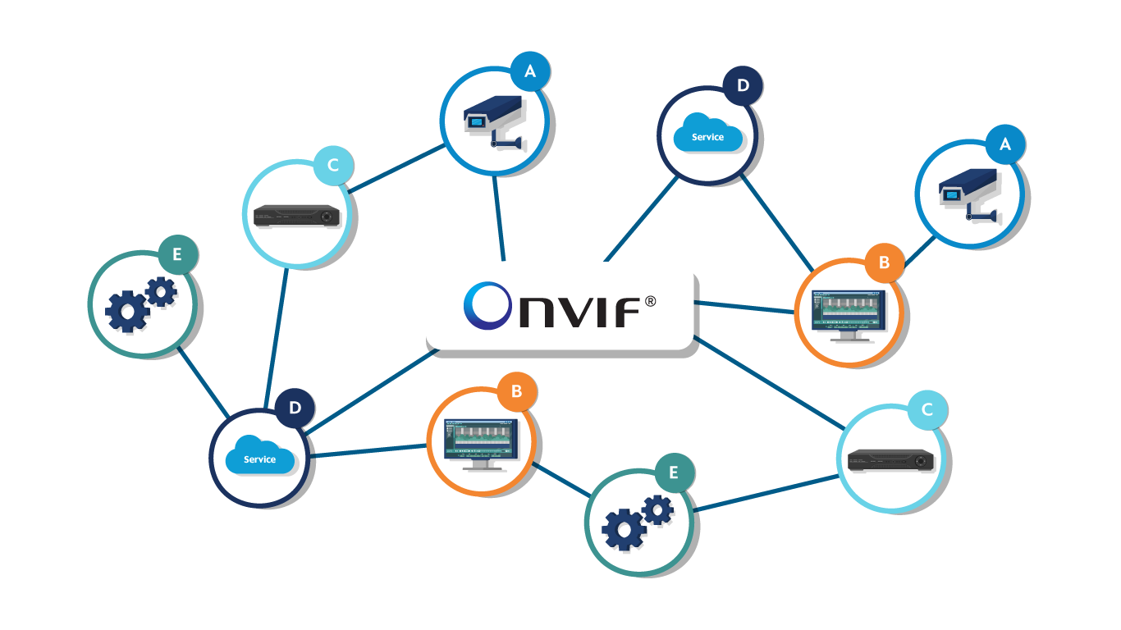
ONVIF Profile M – Benefits
Easier integration of analytics solutions
Easier integration with IoT applications
Greater product choice for system integrators and end users; flexibility to mix and match products from different vendors
Expanded market opportunities for traditional camera and VMS vendors, as well as for independent developers of analytics solutions
Can be combined with other ONVIF video and access control profiles for an integrated system based on ONVIF interfaces
Future proofs your system for a more secure investment
Notes:
ONVIF Profile M makes it easier for system integrators to integrate analytics solutions from conformant devices/services, with conformant clients to solve security, safety and operational efficiency needs.
Profile M also specifies event handling over MQTT, enabling connections with IoT platforms to support IoT applications. (See slides 7 & 8.)
Because integration is made easier, as system integrators and end users, you will have greater product choice. You will have the flexibility to mix and match conformant products from different vendors and implement more intelligent applications.
This profile enables expanded market opportunities not only for the traditional camera and VMS vendors, but also independent developers of solutions with analytics capabilities (could be edge-, server- or cloud-based solutions). Because such Profile M devices or services will have wide compatibility, this will encourage further growth in the number and types of applications, which will result in even greater choice for end users.
Profile M can be combined with other ONVIF video and access control profiles for an integrated system based on ONVIF interfaces.
And having ONVIF profile support in products means you, as end users, are not locked in into any particular brand. It’s like having an insurance policy that future-proofs your system for a more secure investment.

Slide 5

ONVIF Profile M – Supported Metadata
Analytics configuration
Generic object classes
Specified object classes
  Geolocation
  Vehicle
  License plate
  Human face
  Human body
Use cases
  Displaying objects of interest in video
  Heat mapping in retail, vehicle mapping in parking lots
  Forensic search
Play video >
Notes:
ONVIF Profile M supports interfaces that allow users to configure the settings of an analytics application. (The extent of the settings options exposed through ONVIF interfaces depends on the manufacturer.)
The analytics application should also be able to tell a client what metadata is supported.
Analytics metadata can be of a generic type or
specified types like geolocation, vehicle, license plate, human face, and human body.
For generic object classification, ONVIF provides a generic container. The device manufacturer can program an analytics to classify any object, and that metadata can then be sent to a client using the ONVIF generic container. A conformant client simply queries the device for the supported metadata and the client can work with and enable the user to choose among the metadata supported by the device.
Because proprietary analytics may provide metadata output in different forms, ONVIF has specified the most common objects for specification.
1) Geolocation – the location details of a detected object as identified by a PTZ camera, or where the fixed camera is installed
2) Vehicle – vehicle type and information (Vehicle type: car, bus, truck, motorcycle, bicycle are specified by ONVIF. Vehicle info: brand, model, etc. can be set in open ONVIF containers by the device manufacturer.)
3) License plate – plate number, type (normal/police/diplomat/temporary), country or issuing entity
4) Human face
5) Human body
Use cases for metadata:
1) Metadata can be visually displayed in a video stream in the form of boxes around objects of interest. These can help alert security guards to potential threats and make responses quicker and more effective.
2) Human and geolocation metadata can be used to map popular areas in a retail store.
3) Similarly, vehicle and geolocation metadata can be used to identify open spaces in a parking lot.
4) Metadata can be used for forensic search. For instance, is there a certain license plate number on this road at a particular time?

Slide 6

ONVIF Profile M – Supported Events
  Line crossing counter for object counting events
    For gaining visitor statistics, crowd control, visitor or queue management
  License plate recognition events for access control to a parking lot
  Facial recognition events for access control to a building premise
Notes:
In addition to standardizing the metadata so that it can be understood by conformant clients, Profile M specifies the events for specific analytics applications.
These analytics applications are:
1) Line crossing counter for object counting
2) License plate recognition
3) Facial recognition
To be clear, Profile M does not ensure or provide these applications. It simply provides the event interfaces for such analytics so that conformant clients (users) can decide how the system should respond to such events. Support for standardized event topics and event handling makes it easier for integrators to use ONVIF interfaces.
Note that the events for such analytics applications is set as conditional in Profile M. It means that if a conformant product supports such analytics like license plate recognition in a proprietary way, then there should also be Profile M event interfaces for that analytics.
The events that can be sent through such interfaces include standard ONVIF events and events from specific analytics such as license plate recognition for access control to a parking lot.

Slide 7
Profile M – Streaming Metadata & Sending Events
Support for metadata stream is mandatory for all Profile M conformant products.
< Mandatory interface: Standardized metadata stream >
Data in stream: analytics metadata / XML events (e.g. motion alarm) / PTZ positions
Profile M also specifies two conditional methods for communicating events.
< Conditional interface: ONVIF event service >
Data in stream: XML events (e.g. motion alarm)
< Conditional interface: MQTT event >
Data in stream: JSON formatted events (e.g. motion alarm)
Notes:
In addition to standardizing metadata and events for specific analytics applications, Profile M also specifies the standard interfaces for how data from conformant devices can be communicated to conformant clients.
Support for the Profile M metadata stream is mandatory for all Profile M conformant products:
Metadata stream – The interface for the metadata stream (which can carry data such as analytics metadata, XML events such as motion alarm, and PTZ positions) must be supported in all Profile M conformant products.
Profile M also specifies two conditional methods for communicating events
ONVIF event service – This service is through pull-point subscription over HTTP or HTTPS and is the usual transport method (specified by other ONVIF profiles) for communicating XML-based ONVIF events (e.g. motion alarm, or change in configuration/profile). With Profile M, this service is conditional.
MQTT – MQTT (Message Queuing Telemetry Transport) is a transport protocol that is often used by IoT (Internet of Things) applications. Profile M allows you to send JSON (JavaScript Object Notation) formatted events, such as motion alarm, over the MQTT protocol. This streaming interface is conditional; that is, if the product supports the MQTT protocol in any (proprietary) way, then the ONVIF interface for sending events over MQTT needs to be supported. An example of how this can be used is illustrated in the next slide.

Slide 8
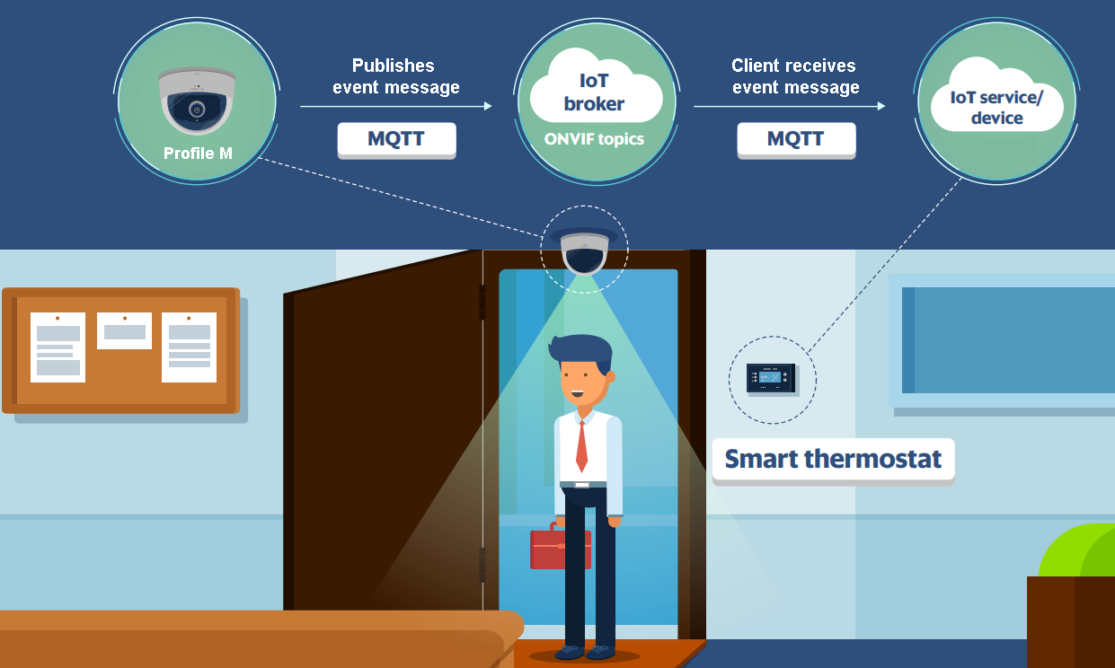
ONVIF Profile M – For IoT Systems
Sends JSON event over MQTT – transport method used often by IoT applications
Use case
  Room temperature control
Notes:
Profile M devices or clients with support for MQTT can also communicate with an IoT platform/application that can then communicate with IoT services or devices.
Use case:
An example of an IoT use case can be for room temperature control, where a Profile M camera (with MQTT support) detects humans in a room and sends an ONVIF event over MQTT to an IoT platform or application that, in turn, triggers a smart thermostat to adjust the room temperature.
Technical details:
Profile M conformant devices with MQTT should support, among other things:
the retrieval of supported topics
event filtering (TopicFilter as described in the ONVIF Core Specification)
the listing of event-broker configurations
adding and changing the configuration of the MQTT broker
removing an event broker

Slide 9
Profile M feature list compared with Profile T

Slide 10
Profile M vs. Profile T feature list
Feature | Profile M |  | Profile T
 | Device | Client | Device | Client
1. Metadata streaming | M | M | M | C
2. Media profile for metadata streaming out of the box | M | M | - | -
3. Metadata configuration | M | O | M | C
4. Supported metadata | M | M | - | -
5. Image sending within metadata stream | C | C | - | -
6. Video streaming | C | C | M | M
7. Media profile for video streaming ready out of the box | C | C | M | M
8. Event service (e.g. pull-point) | C | C | M | M
9. Event handling using MQTT | C | C | - | -
10. Analytics module | Analytics module configuration | Analytics profile configuration | M | M | M | C | O | C | - | -
11. Rule / Rules configuration | C | C | - | -
12. Face recognition rule, License plate recognition rule, Line crossing counter rule | C | C | - | -
13. Object classication | C | C | - | -
14. System settings (e.g. factory default, set date and time) | C | C | M | C
15. Device discovery | O | M | M | M
16. Network configuration | - | - | M | M
17. Media transport: RTP/UDP/RTSP/HTTP/TCP | M | M | M | M
Notes:
M=mandatory, C=conditional, O=optional features
Compared with other ONVIF profiles, Profile M relaxed requirements on device/network/system management specifications to enable a variety of software-based analytics solutions to qualify as a Profile M conformant device.
Key highlights of Profile M vs. Profile T:
1. Metadata streaming [Enables device to send and client to receive a metadata stream through the preferred transport method]
– Mandatory for Profile M device/client, and Profile T device, but conditional for Profile T clients.
2. Media profile for metadata streaming out of the box [Enables the device to stream metadata out-of-the-box]
– Mandatory for Profile M. Not supported by Profile T.
3. Metadata configuration [Enables client to add the metadata components (analytics metadata / XML events (e.g. motion alarm) / PTZ positions) to the metadata stream]
4. Supported metadata [Enables device to send and a client to receive a sample of a metadata frame generated by an analytics application]
- Conditional for Profile M. Not supported by Profile T.
5. Image sending within metadata stream [Base64 image data (e.g. snapshot of a license plate) can be included in a metadata stream]
– Conditional for Profile M. Not supported by Profile T.
6. Video streaming [Standard H.264/H.265 encoded video stream over RTP/UDP, RTP/RTSP/HTTP/TCP]
- Not a mandatory requirement for Profile M because analytics solutions do not have to be video-based. Video streaming is mandatory for Profile T.
7. Media profile for video streaming ready out of the box
- Not a mandatory requirement for Profile M because analytics solutions do not have to be video-based. Video streaming is mandatory for Profile T.
8. Event service (e.g. pull-point)
– Conditional for Profile M because events can be included in metadata stream. Mandatory for Profile T.
9. Event handling using MQTT
- Conditional for Profile M. Not supported by Profile T.
10. Analytics module [Enables device to add or remove a specific analytics application’s metadata]
Analytics module configuration [Enables device to send and the client to receive a list of available analytics applications and set options for a particular analytics application]
Analytics profile configuration [Enables device to send and the client to receive a stream of analytics metadata]
- Not supported by Profile T.
11. Rule / Rules configuration [Enables device to send and the client to list the supported rules, and a client to set the rules for triggering an event]
- Conditional for Profile M. Not supported by Profile T.
12. Face recognition rule, License plate recognition rule, Line crossing counter rule
- Conditional for Profile M. Not supported by Profile T.
13. Object classication
- Conditional for Profile M. Not supported by Profile T.
14. System settings (e.g. factory default, set date+time)
– Subset of interfaces are conditional for Profile M device/client, but mandatory for Profile T device and conditional for Profile T client.
15. Device discovery
– Subset of interfaces are conditional for Profile M, but mandatory for Profile T.
16. Network configuration
– Not supported/required by Profile M (to reduce required specifications), but mandatory for Profile T.
17. Media transport: RTP/UDP/RTSP/HTTP/TCP
Mandatory for Profile M and Profile T.
For a complete list and to see how Profile M compares with other ONVIF profiles in supported features, go to the ONVIF Profile Feature Overview document available here: https://www.onvif.org/profiles/
For the Profile M specification, go to: https://www.onvif.org/profiles/profile-m/

Slide 11
How to know what features are supported by a conformant product
Notes:
All ONVIF profiles have mandatory and conditional features. So how can a customer easily know what features a conformant product supports?
Besides looking at the specifications on a product datasheet from the manufacturer, there are two ways of finding this information. One way is publicly available and the second way is available for members. So let’s look first at the publicly available method.

Slide 12
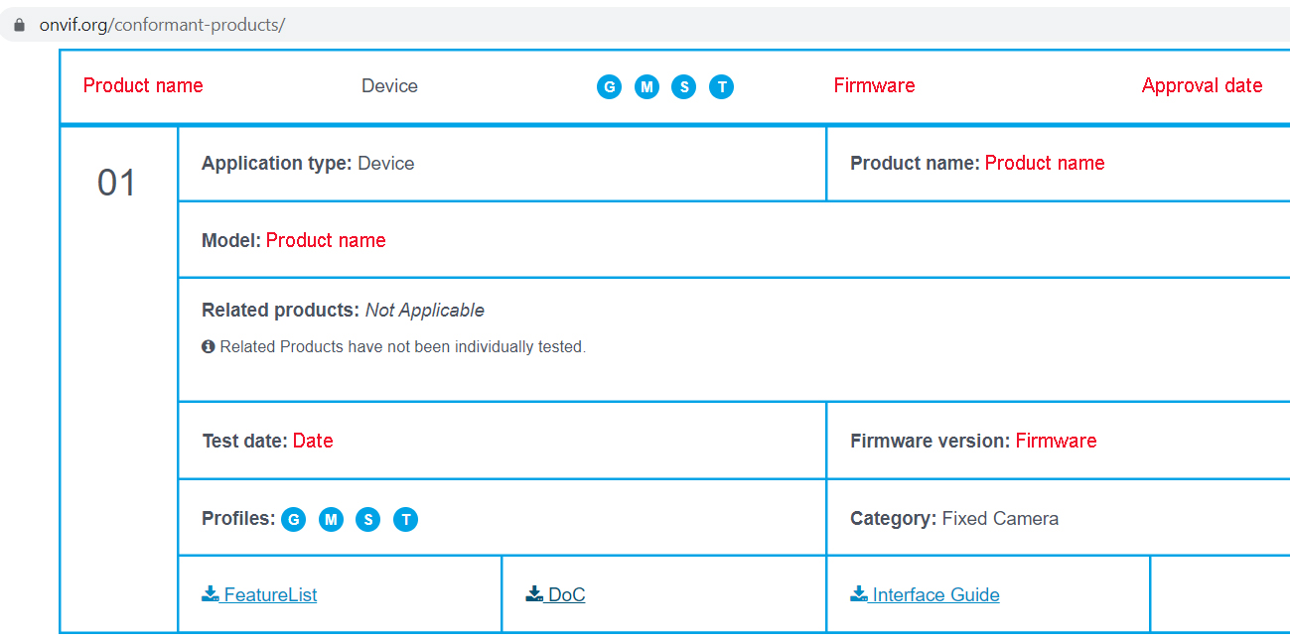

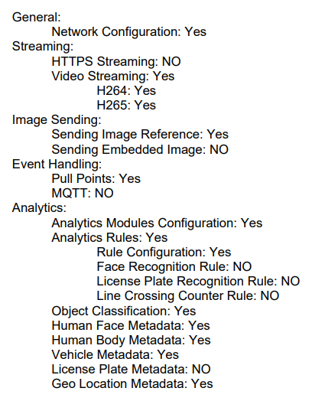

Information on DoC (Declaration of Conformance)
Notes:
Each and every ONVIF conformant product has an ONVIF declaration of conformance (DoC) document that is publicly accessible through the Conformant Products web page on www.onvif.org/conformant-products/ . Here we show an example for a conformant device.
When you download the DoC, the document will show the features of the profile that the product supports. We show here a snapshot of the supported Profile M features.

Slide 13
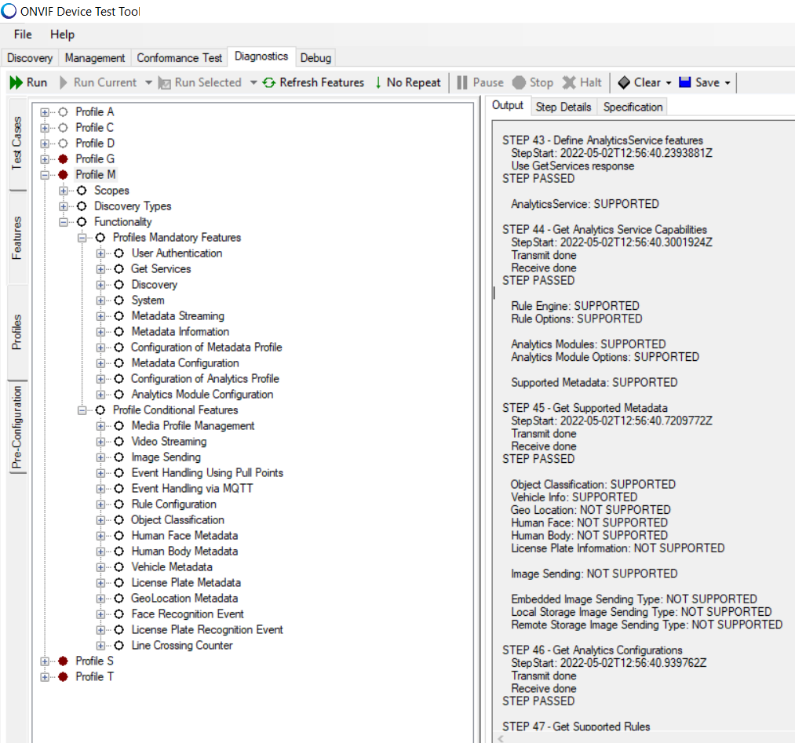
Use of test tool
Open test tool, which shows Profile M’s list of mandatory and conditional features
Connect tool to device’s IP address and click on “Refresh Features” for Output of results
Notes:
The second way of knowing what features are supported is through the use of the ONVIF device test tool, which is available to all ONVIF members, including Observer-level members, on the ONVIF Member Portal: https://www.onvif.org/member-portal
Simply open the test tool and see what features are mandatory and conditional.
Connect the tool to the device’s IP address. Click on ”Refresh Features” menu to get an output of what is and isn’t supported.

